Slide 1
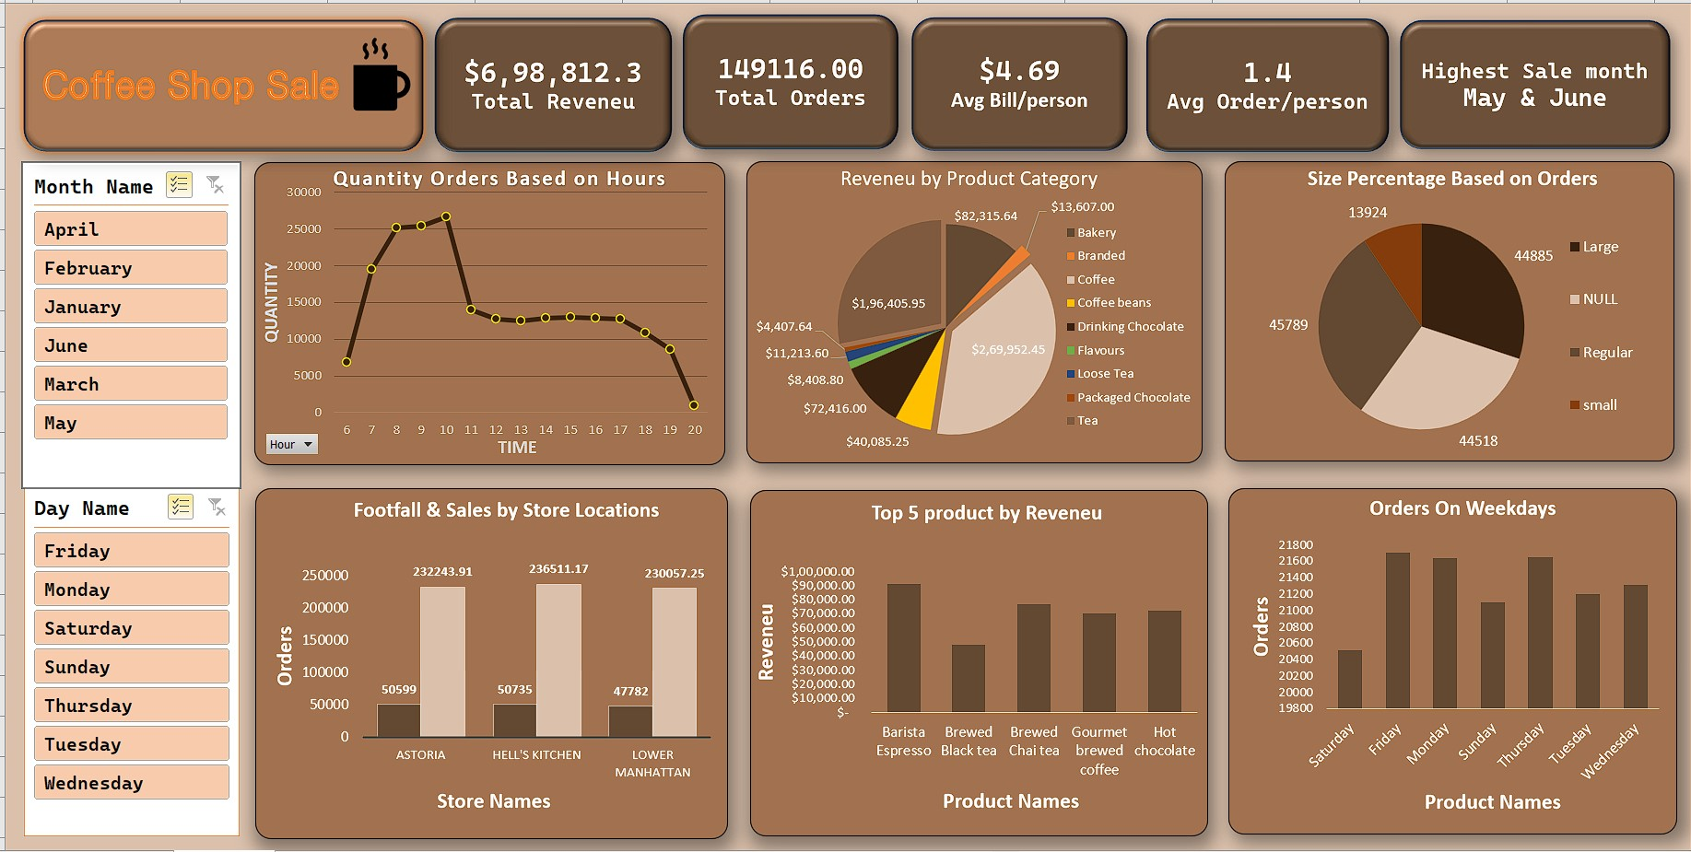

Slide 2
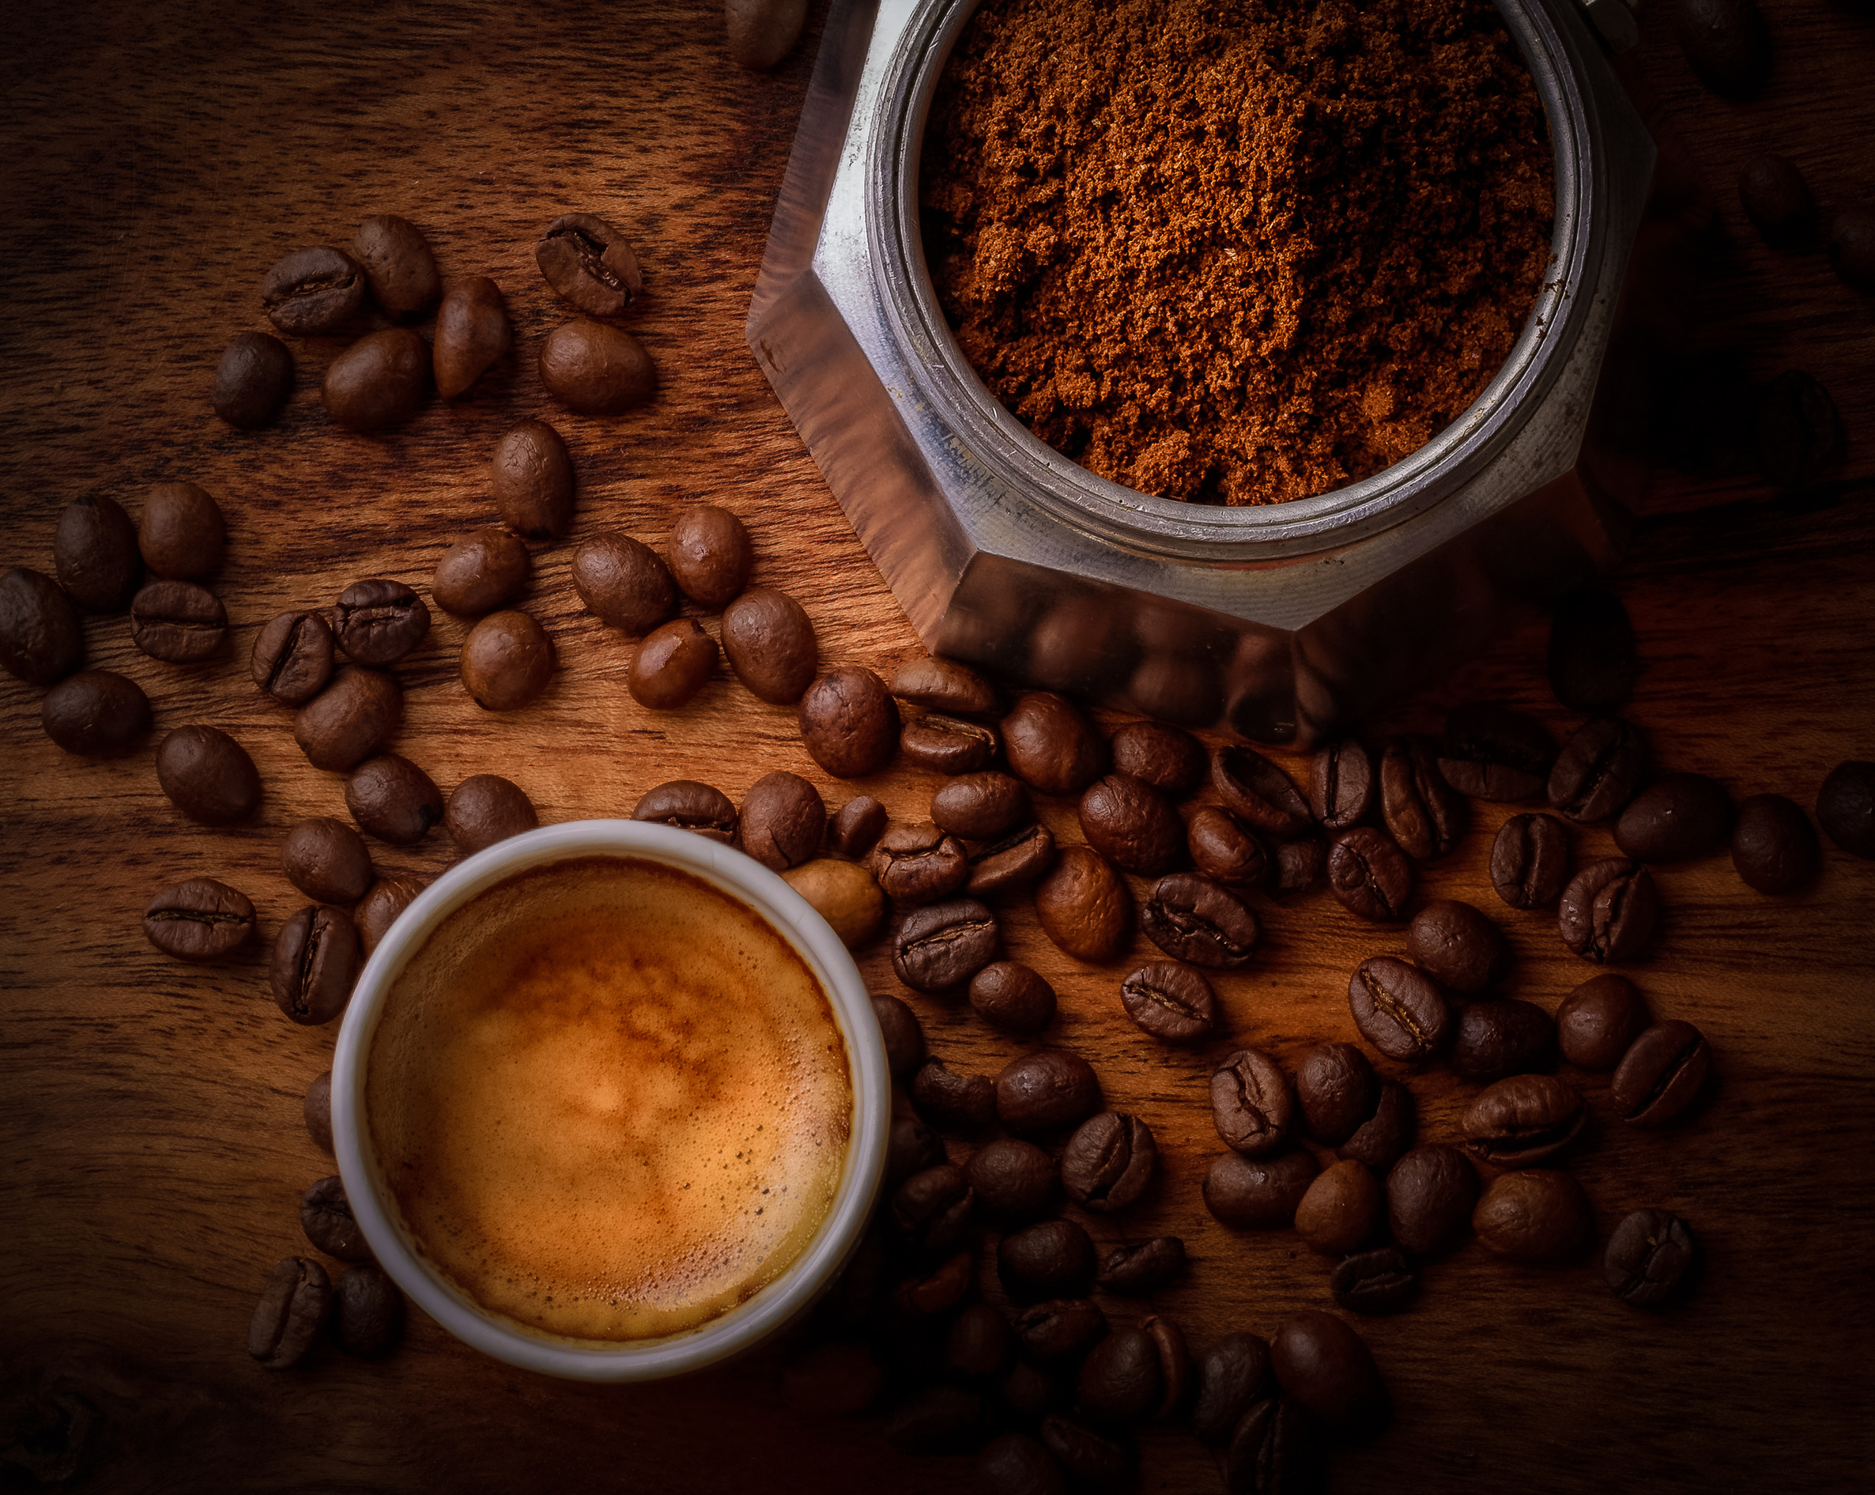
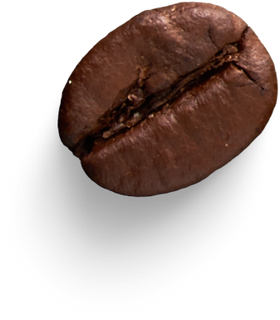
Coffee Sale Analysis
By Rajdeep banik

Slide 3


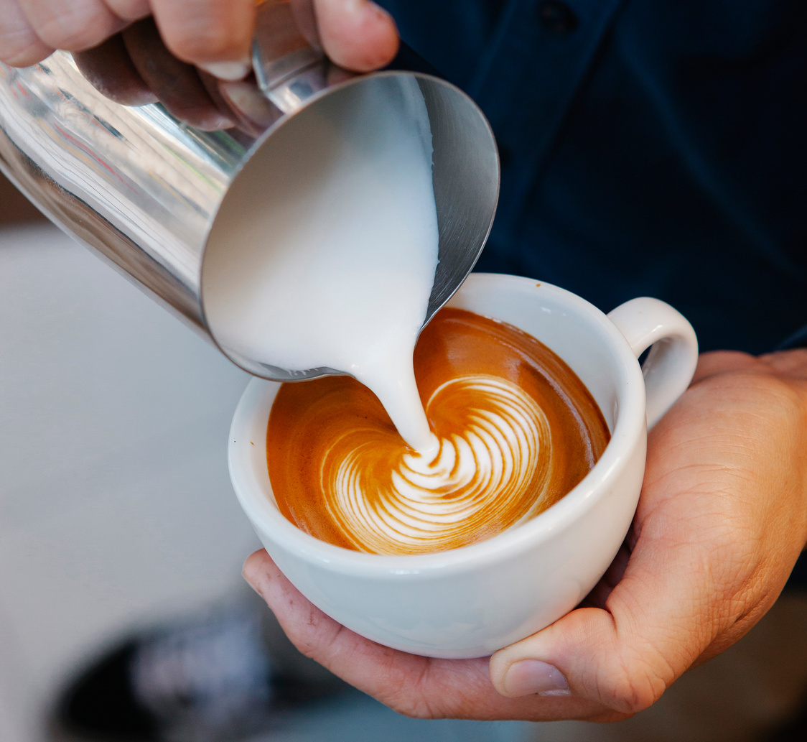
Main Objective
The primary goal of this project is to examine retail sales data in order to extract valuable insights that can improve the CoffeeShop's performance.

Slide 4

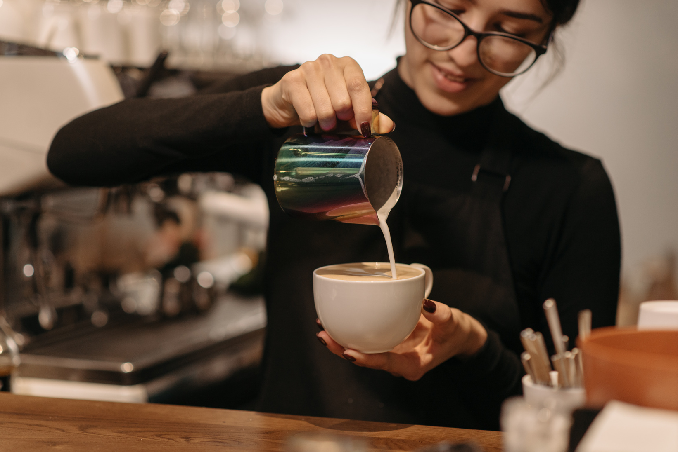
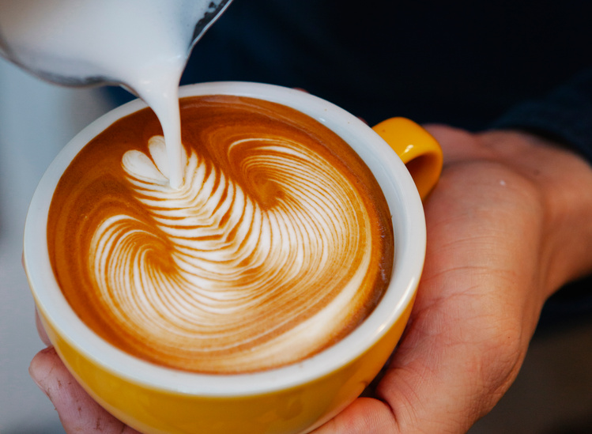
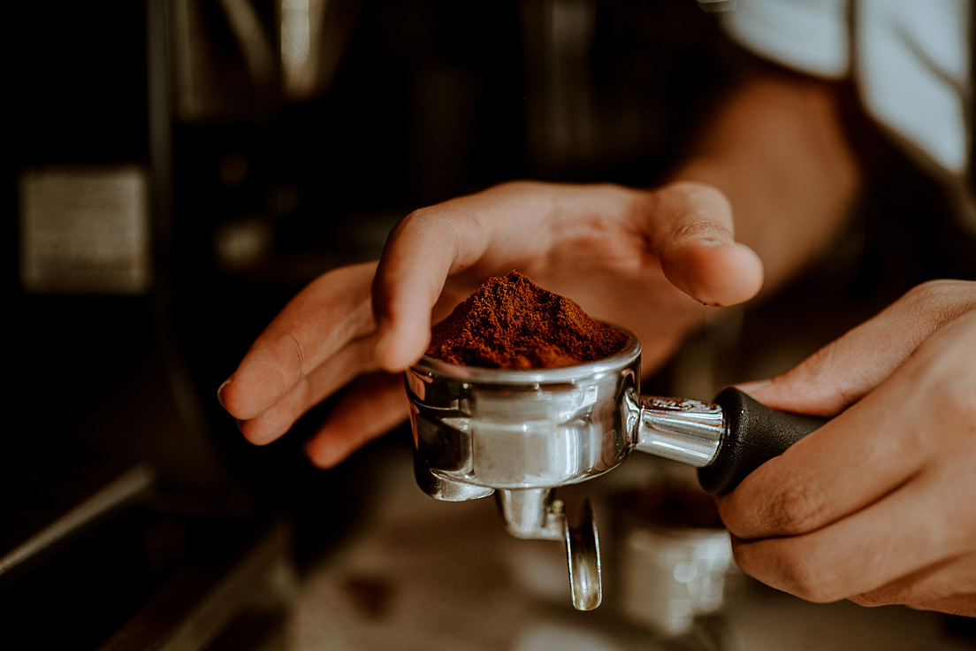

Problem Statement:
How do sales vary by day of the week and hour of the day?
Are there any peak times for sales activity?
What is the total sales revenue for each month?
How do sales vary across different store locations?
What is the average price per order per person?
Which products are the best-selling in terms of quantity and revenue?
How do sales vary by product category and type?

Slide 5
Analysis of Key Insights

Slide 6





Analysis
01
How do sales vary by day of the week and hour of the day?
Are there any peak times for sales activity?
Sales peak on Friday with 21,701 units, closely followed by Thursday, Sunday and Monday.
On an hourly basis, the highest sales activity occurs between 8 AM and 10 AM, with the peak at 10 AM (22,983 units).
These insights suggest mornings and Fridays are the most active times for sales.

Slide 7
Analysis
02
What is the total sales revenue for each month?
The total sales revenue varies across the first half of the year, with June generating the highest at $144,301.18, followed closely by May at $137,422.95.
Sales were lower in the earlier months, with January and February bringing in $68,935.22 and $64,770.14, respectively, showing a significant upward trend toward mid-year.

Slide 8
Analysis
03
How do sales vary across different store locations?
Sales across different store locations show slight variations, with Hell's Kitchen leading at $202,825.54, followed by Astoria at $199,448.73, and Lower Manhattan at $198,207.75.
While the differences are minimal, Hell's Kitchen consistently outperforms the other locations, indicating a slightly higher sales activity in that area.

Slide 9
Analysis
04
what is the average price a person pay in per order?
The average price per order per person is calculated by multiplying the average price by the average order quantity. With an average price of $4.69 and an average order of 1.4, the average price per order per person is $6.57.

Slide 10
Analysis
05
Which products are the best-selling in terms of quantity and revenue?
The best-selling product in terms of revenue is Barista Espresso, generating $78,502.70. In terms of quantity the exact numbers aren't provided, Barista Espresso likely also leads due to its high revenue, followed by Brewed Chai Tea at $66,415.60 and Hot Chocolate at $62,308.75.

Slide 11
Analysis
06
How do sales vary by product category and type?
Sales vary significantly by product category and type. The Coffee category leads with $231,815.90 in revenue, followed by Tea at $168,944.10.
In terms of product types, Barista Espresso tops the list with $78,502.70, while Brewed Chai Tea and Hot Chocolate also perform well, indicating strong preferences for these specific items within their categories.

Slide 12
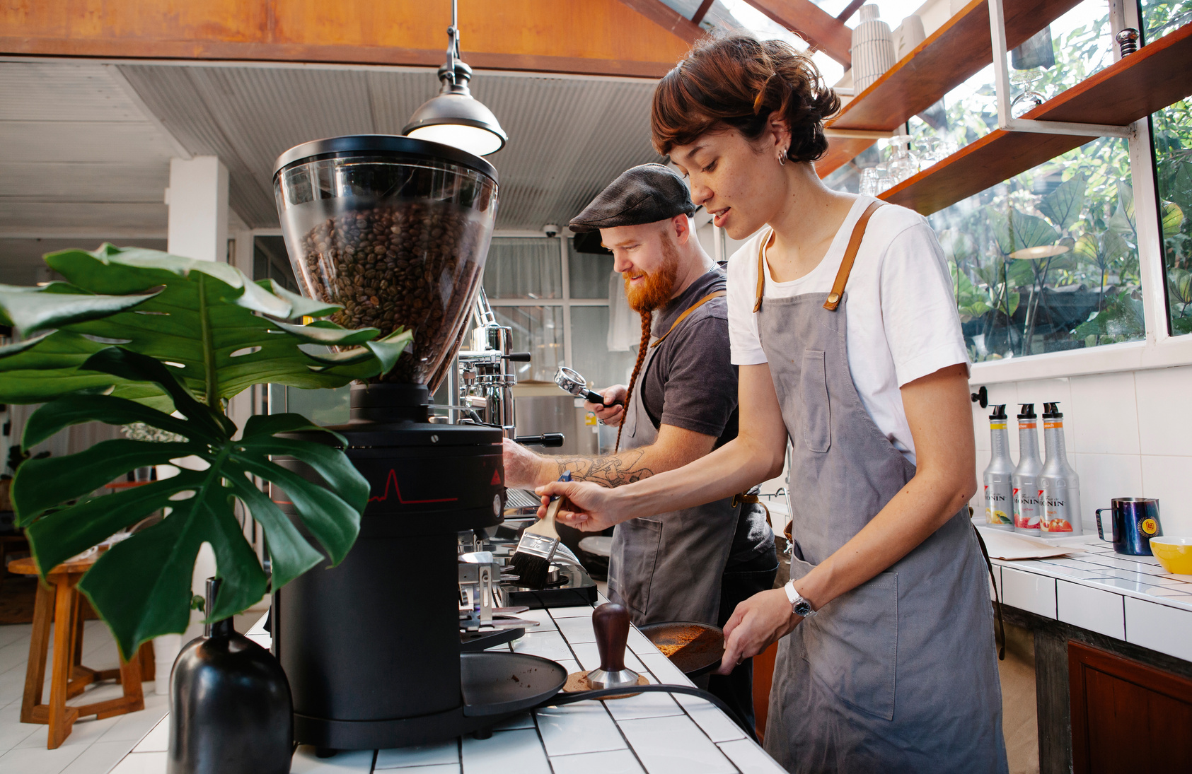
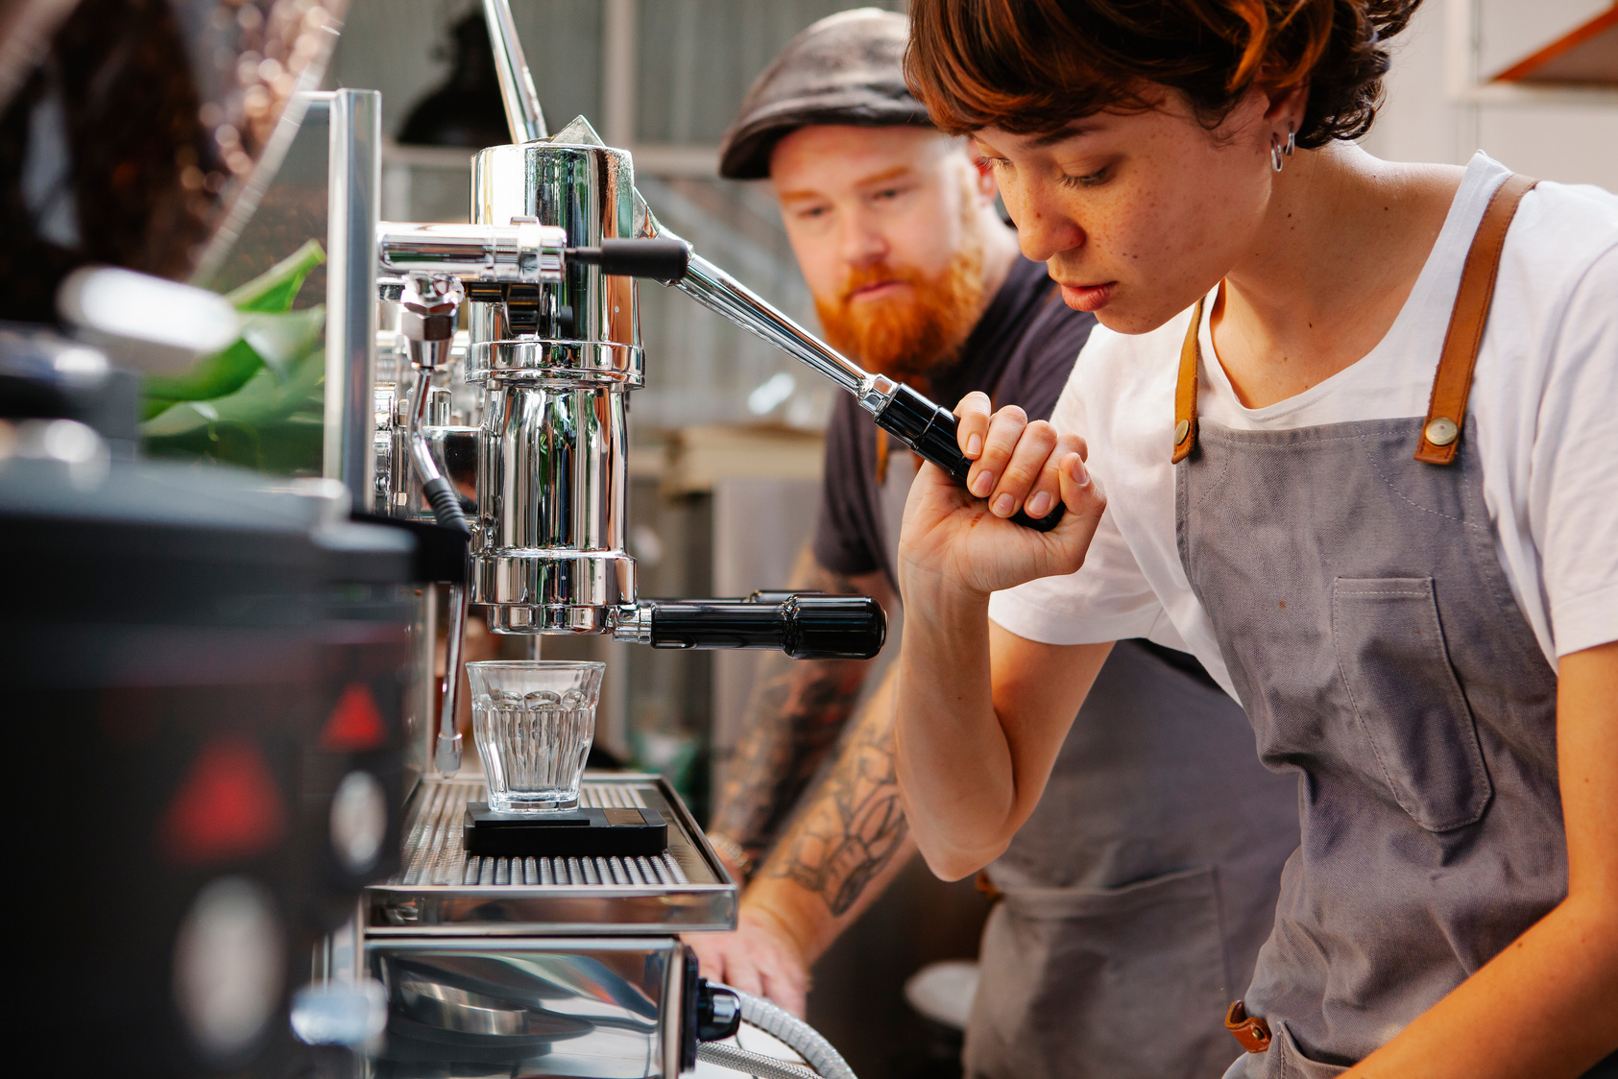
Summary
Sales analysis reveals that Coffee is the leading product category, generating $231K in revenue, followed by Tea at $168K.
Barista Espresso emerges as the top-selling product type with $78k in revenue. Other strong performers include Brewed Chai Tea ($66K) and Hot Chocolate ($62K).
The Bakery category also contributes significantly with $70K. This suggests a strong customer preference for coffee-related products and specific beverages like espresso and chai tea, highlighting key areas of focus for maximizing sales and marketing efforts.

Slide 13

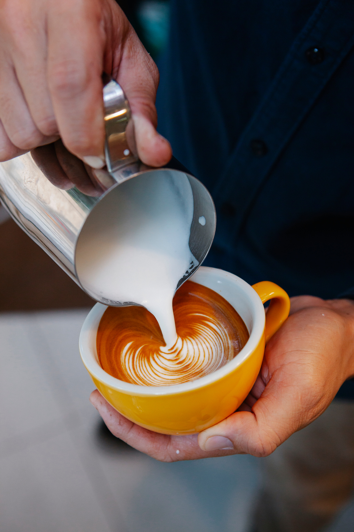

Thank You

